Slide 1

Popular movie datasets
Group Members:
Meghna Godbole
Sharon Lobo
Shubhrata Gupta
Uzma Shah
Group - 6

Slide 2
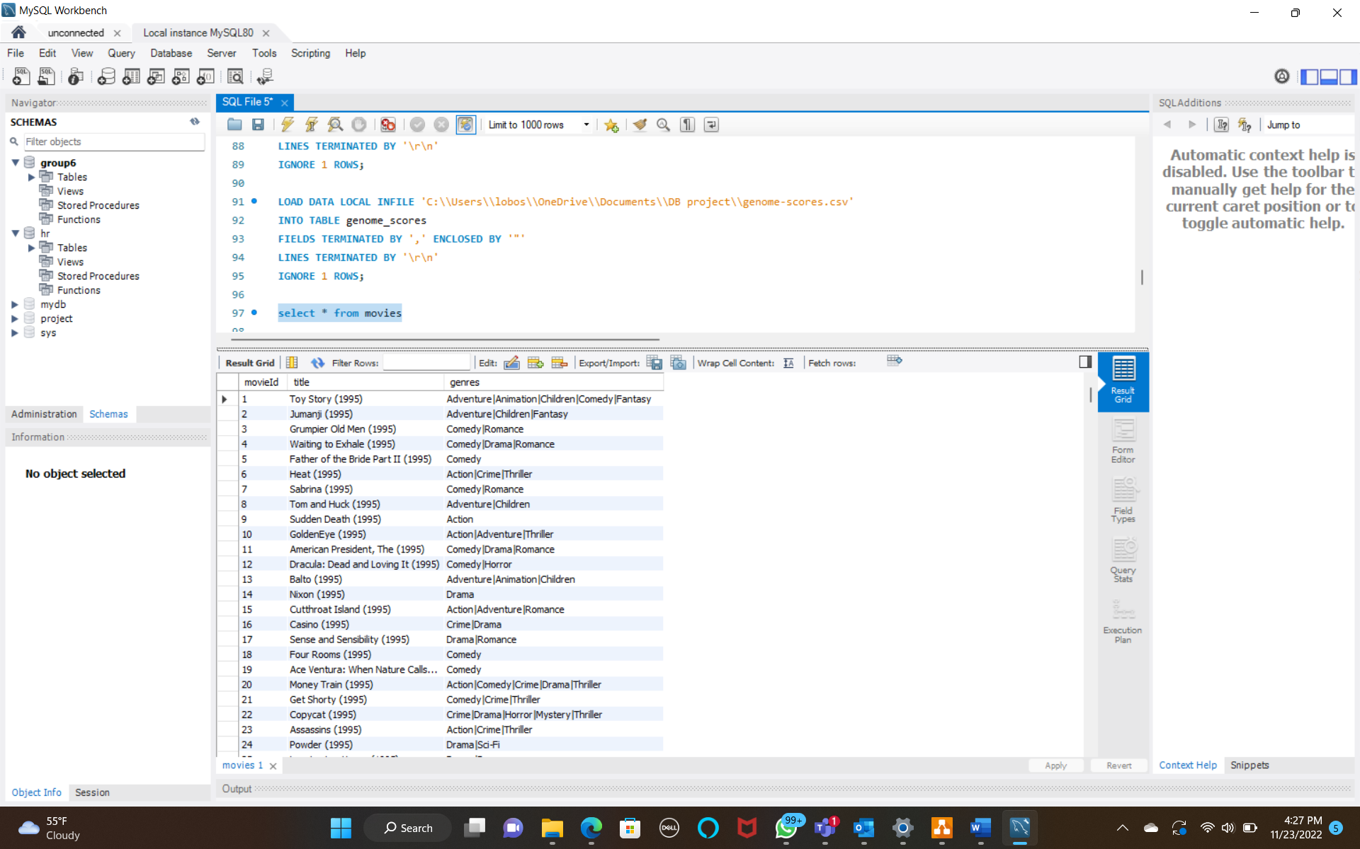
Business Objective
Our movie analyzer system yields a clear understanding of the movie trends. When a person reviews a particular movie, rates it as per relevance, the raw data doesn’t provide useful metrics but after extracting necessary information through our system by data cleaning techniques, we obtain data which would impact the film industry.
E.g.: - The title is an attribute of the movie table. Title consists of the movie name and the release year in one field. Since both pieces of information are equally vital for analysis, we created a view and divided them in two columns. This way we were able to create time-based analysis.

Slide 3
Target audience
Our target audience is the film makers/ film producers. If the film industry is aware of the audience’s favorite genre, it would pave the path for future planning to yield the best possible return based on historical data.
This data is beneficial for the film industry to get an overview of the most recent trends hereby fulfilling the objective of the movie analyzer system.
Problem
The main problem we are facing is the that the industry is unaware of people’s choices which hereby leaves us with an inability to produce movies as per people’s liking. If a movie fails to impress the audience, it will also impact the profit it yields, which in turn results in severe losses.
By aimlessly producing movies without an understanding of the audience’s preference leads to uncertainty in profits which is the foremost factor. With the dataset and insights, which we have drawn we can determine how to optimize the reviews gathered and augment the profits.

Slide 4
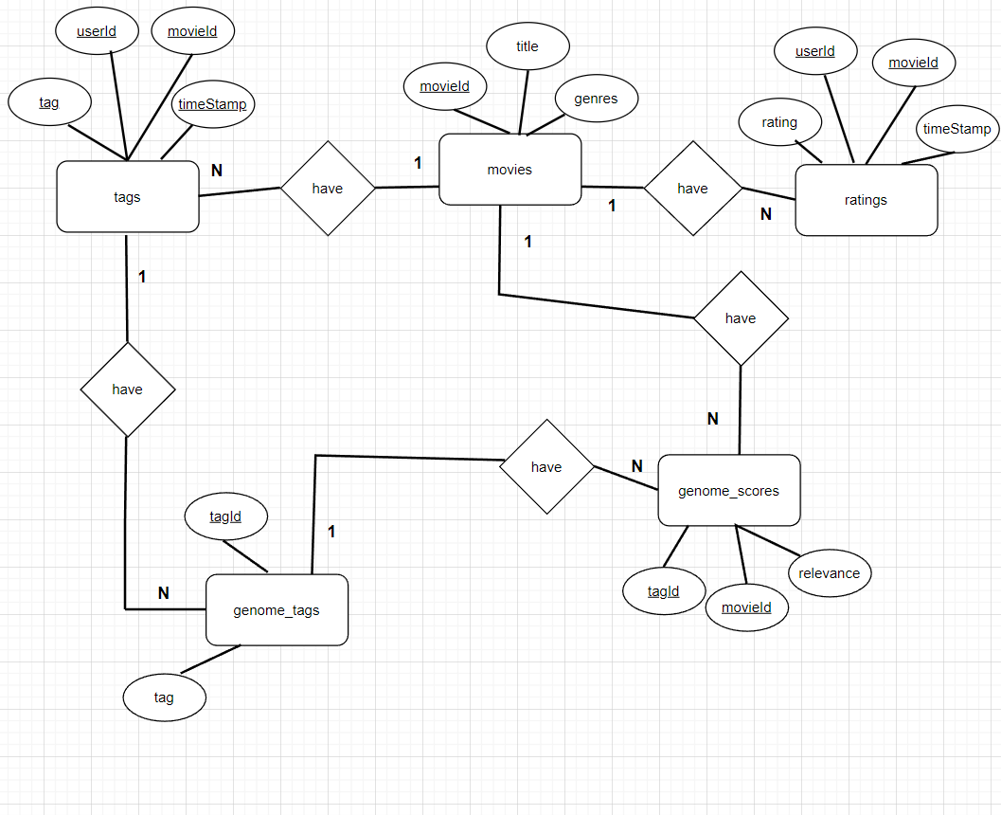
Conceptual Model

Slide 5
Content of the dataset
The movie analyzer system is a new business concept that can allow movie makers, content creators and the film industry to receive an in-depth analysis of every movie by the viewers. This specific data set includes five different CSV files titled 'movies’, 'ratings,' 'tags’, ‘genome-scores’ and 'genomes-tags’. These files contain movie reviews along with the required information for analysis.
Movie table:
• Movie id, title, genre
Ratings table:
• User id, movie id, rating, timestamp
Tags table:
• Tag, user id, movie id, timestamp
Genome-scores table:
• Tag id, tag
Genome-tag table:
• Movie id, tag id, relevance

Slide 6
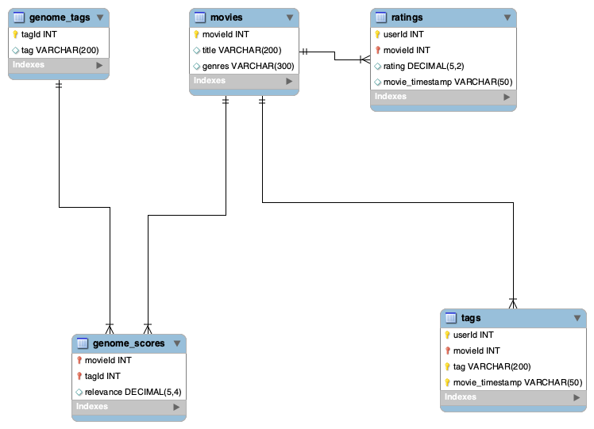
Logical Model

Slide 7
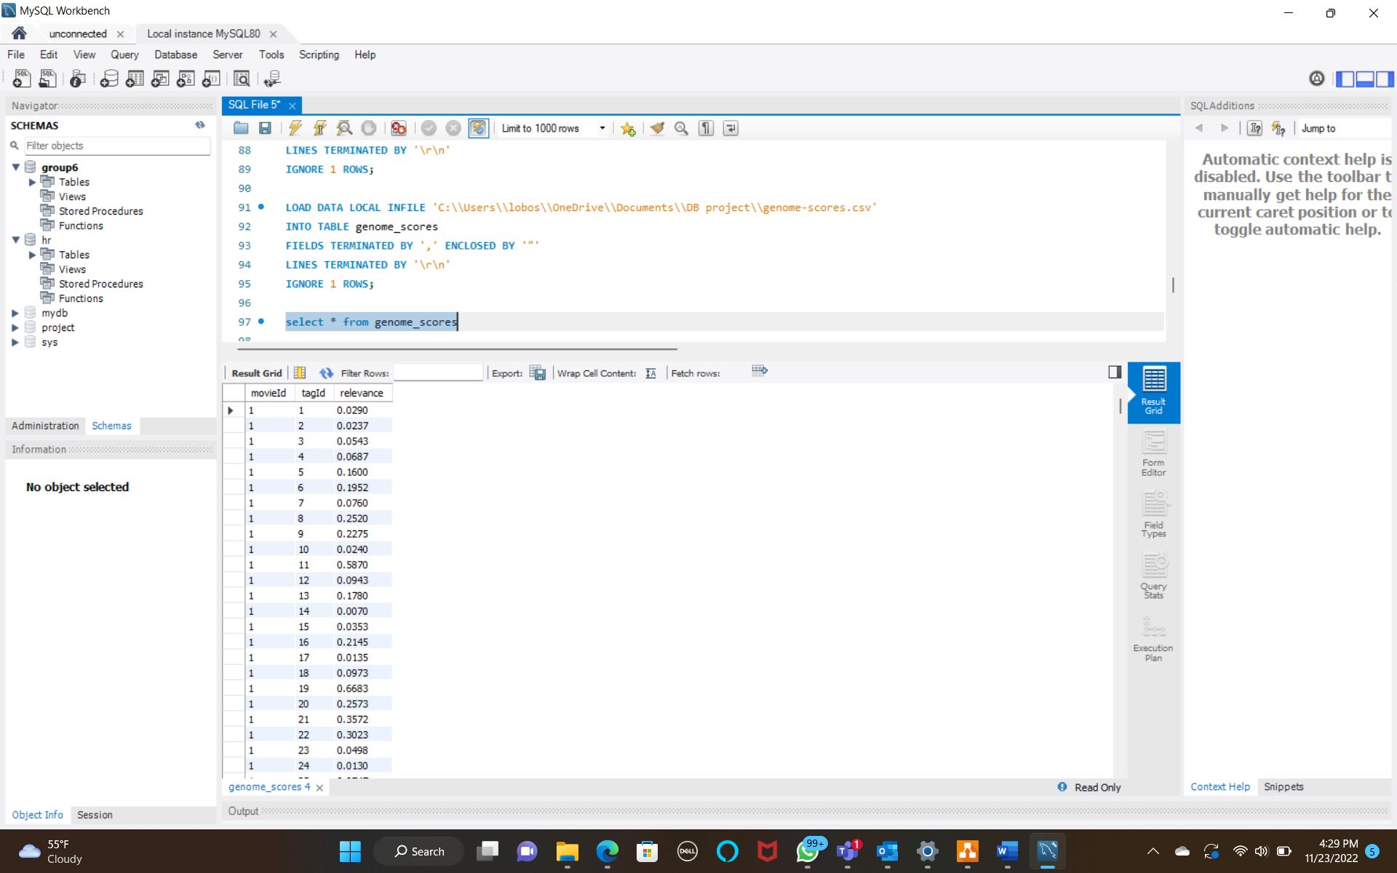
Data Loading Concept:
The dataset contained links table, but the table mostly consisted of ids in each column which didn’t provide any useful insight not only for the user but also for the film industry, thereby not adding any value. Hence, to make the data relevant and precise, we dropped the links table.
Another problem faced during execution is the session timeout problem for the ratings and genome scores table. To overcome this issue, we created an index on each table and uploaded the data. Later, we created primary keys for the respective table, thereby solving the problem.
The relevance scores provided to us via the data set had scores with varied places of decimal. E.g.: - 0.029, 0.16, 0.06875, 0.0135 etc. For uniformity and accurate comparison, we rounded the scores to four decimal places.

Slide 8
Project Insights
The movie industry has been booming since ages. Even though it is loved by all there seems to be a constant struggle to maintain a standard in the industry. To ensure popularity among the audience, there are a few questions the film industry needs to take into consideration.
The film industry should ponder upon the below questions to amplify their success.
Name of top movies in each genre?
How are the movie trends changing every 20 years?
What is the spread of audience ratings across various genres?
In the year 1930 - 1931, out of the top-rated movies (with 5-star ratings) which tag is the most relevant to the title?
What is the average number of tags assigned to a movie?
What are the top 10 genres of movies that have the highest average ratings?
What are the top-rated movies in each genre?
What was the number of movies releasing every 3-year starting 2000?
Count of movies in each genre?
Which users have given the most relevant tags?

Slide 9
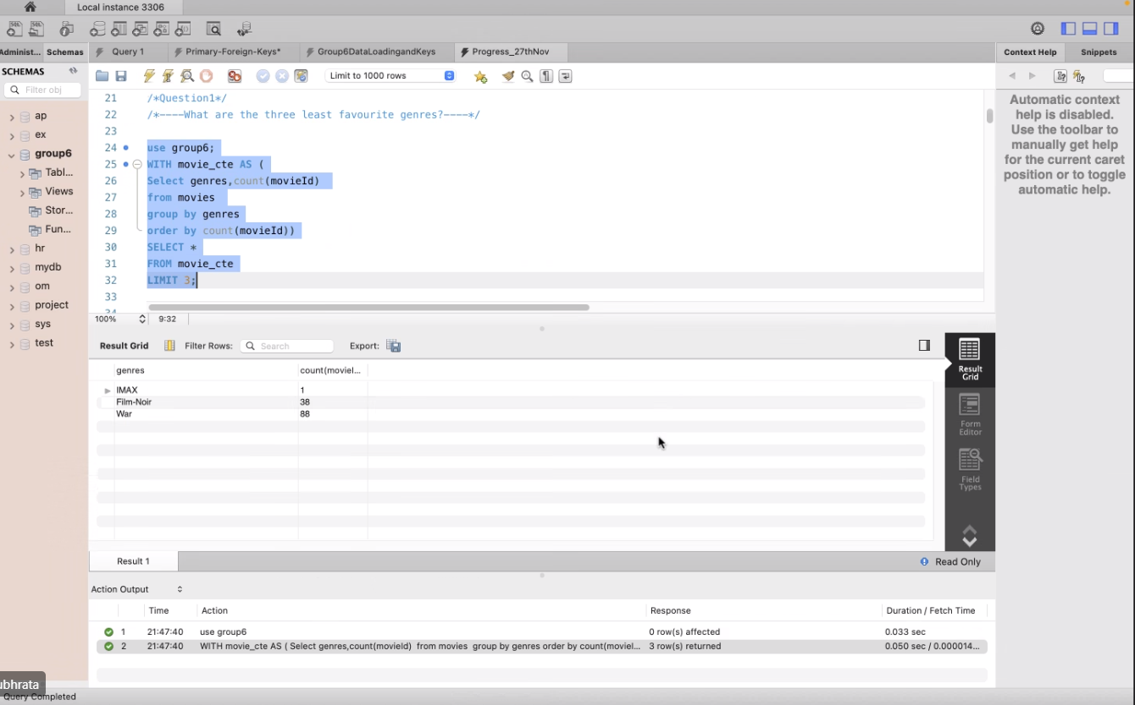
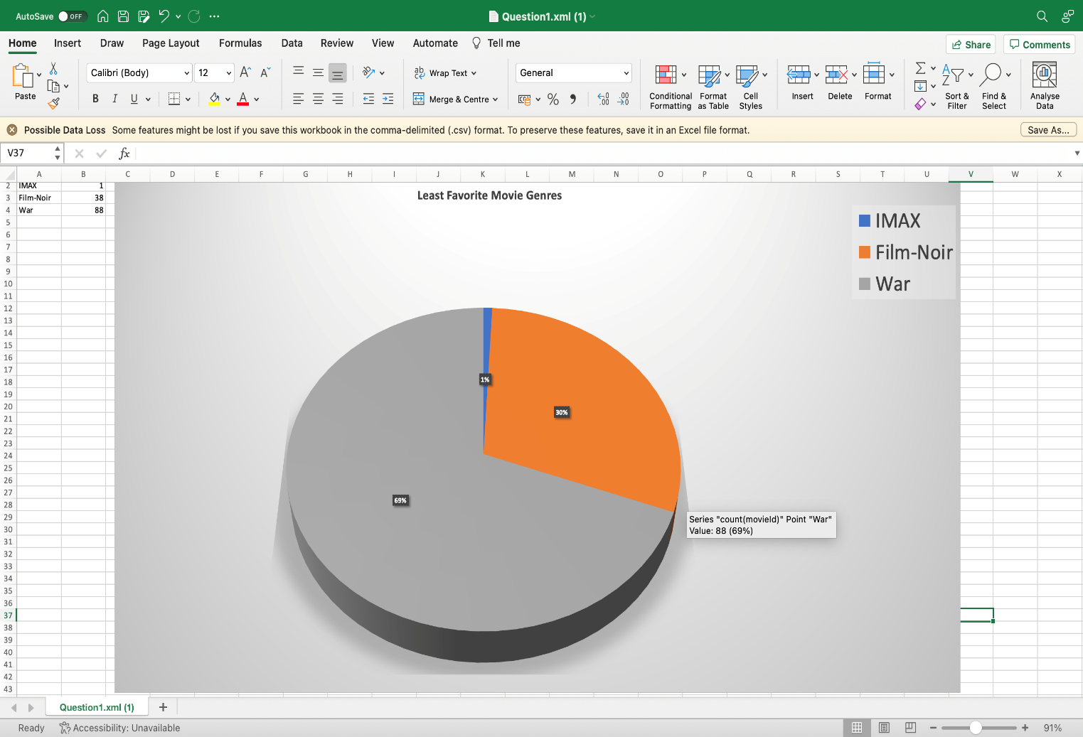
Outcome
The SQL Queries apply advanced SQL concepts such as View, CTE, Partition with/without Rank. They are thereby used for analytics and improved performance.
What are the three least favorite genres?

Slide 10
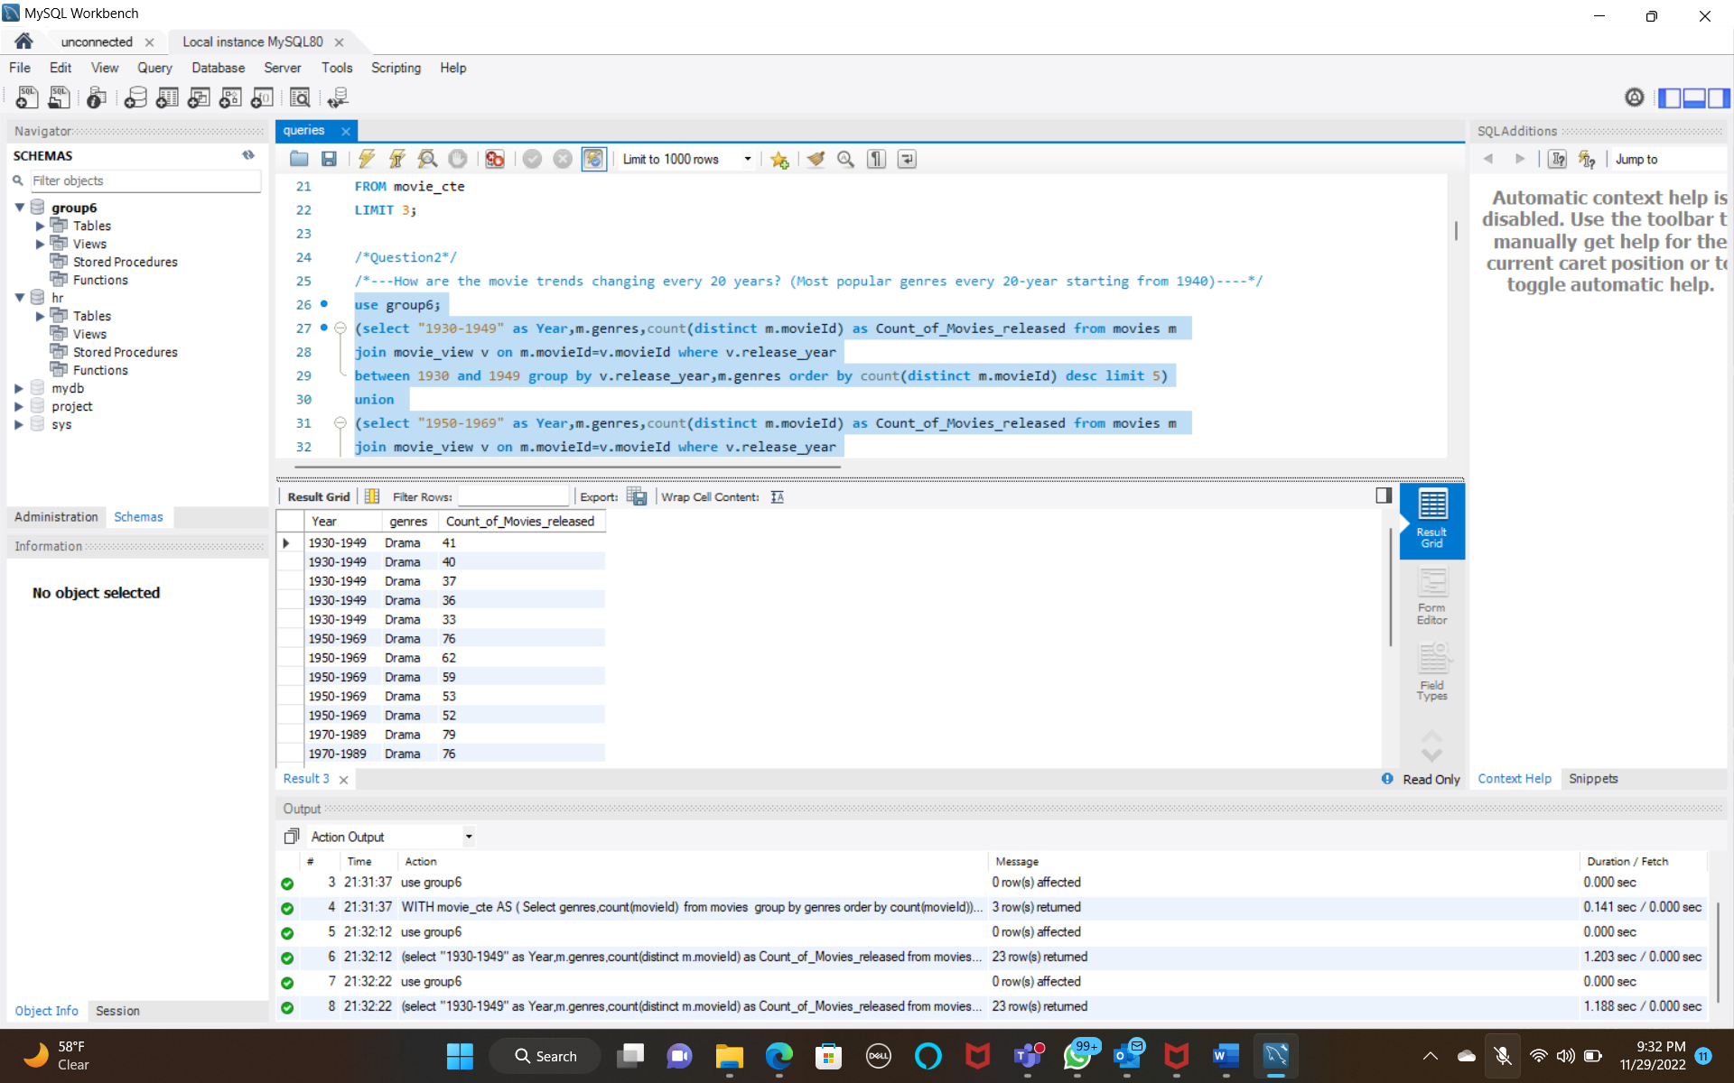
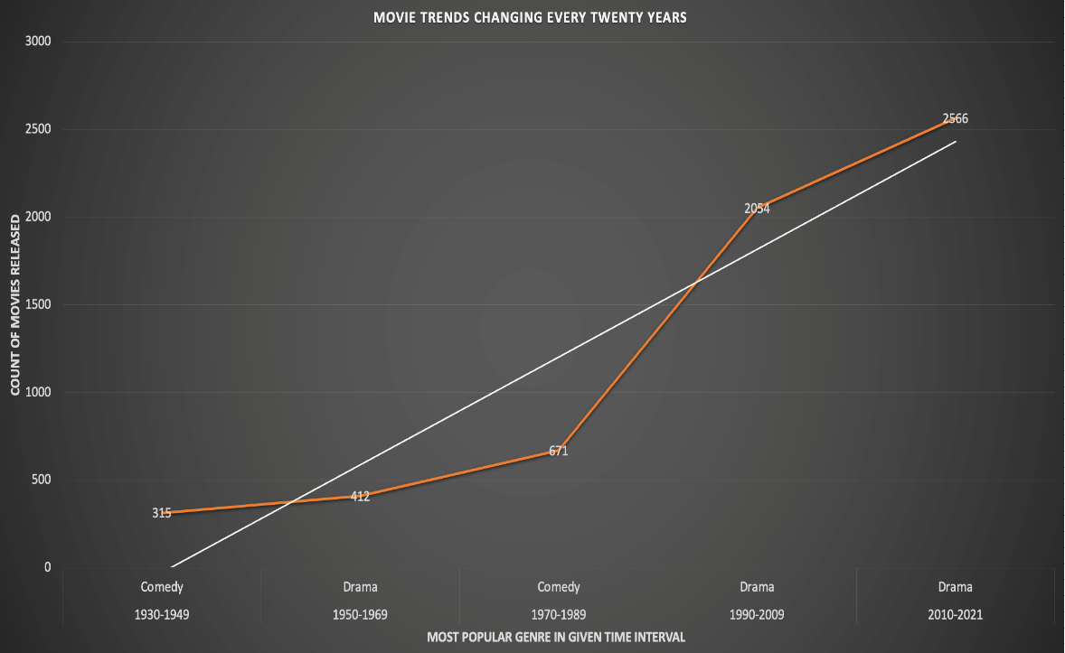
2. How are the movie trends changing every 20 years?

Slide 11
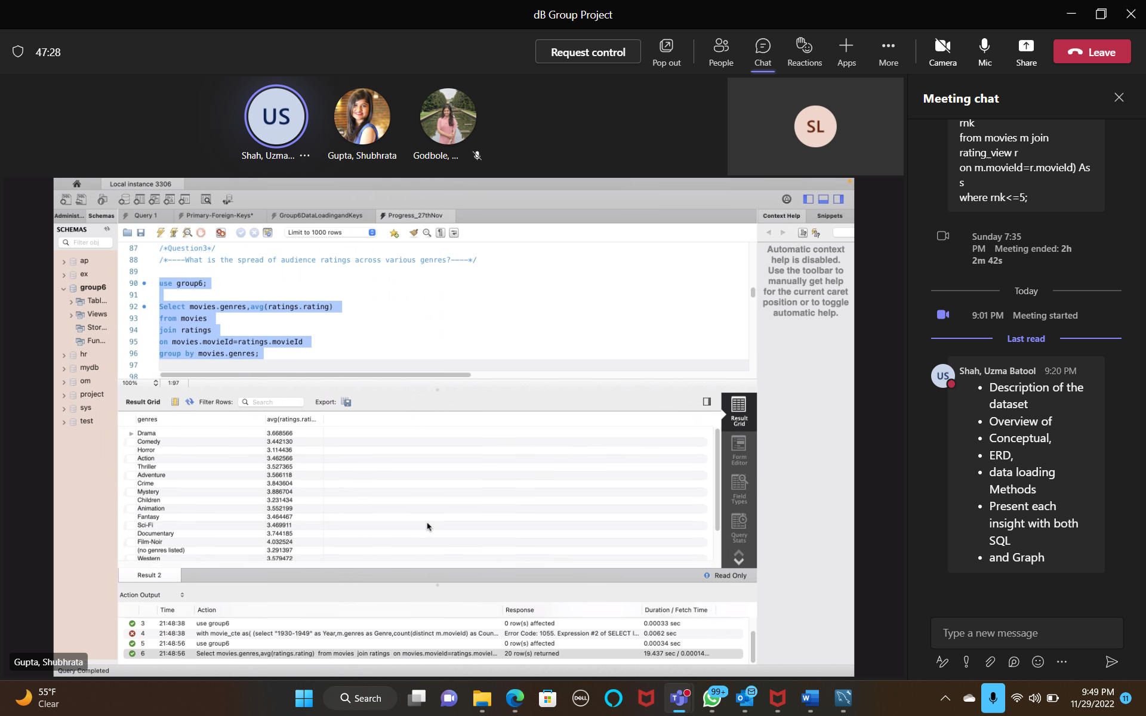
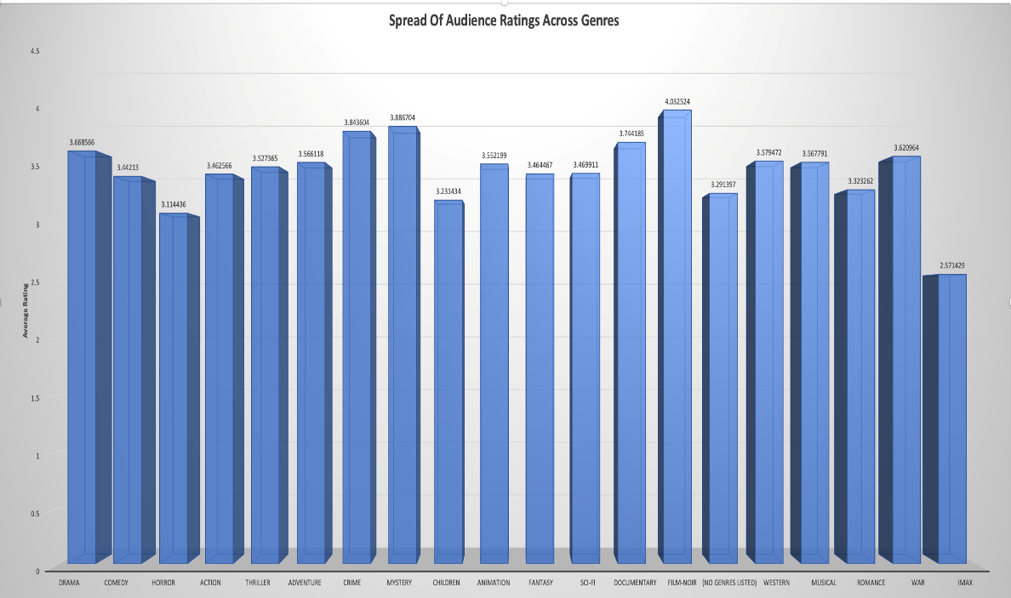
3. What is the spread of audience ratings across various genres?

Slide 12
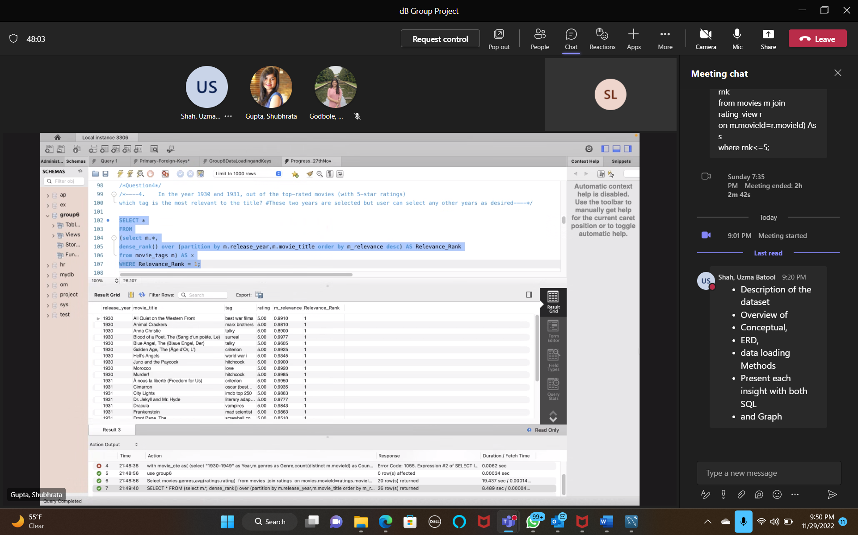
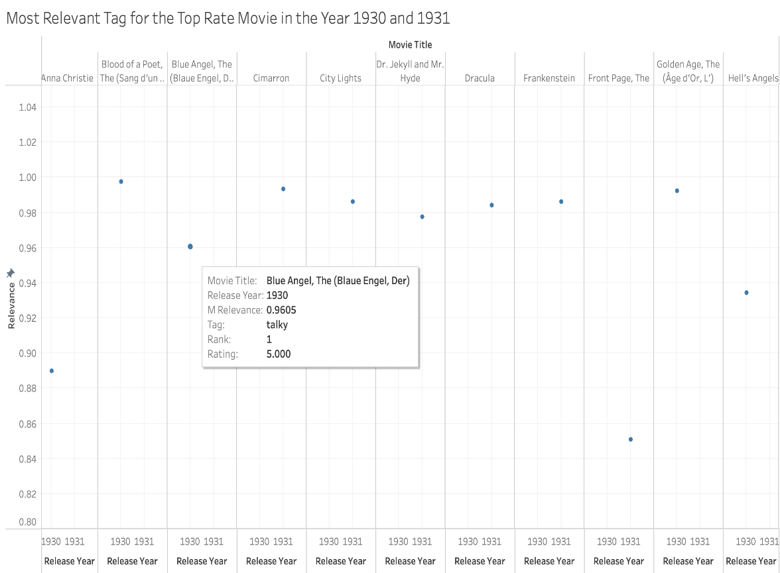
4. In the year 1930 - 1931, out of the top-rated movies (with 5-star ratings) which tag is the most relevant to the title?

Slide 13
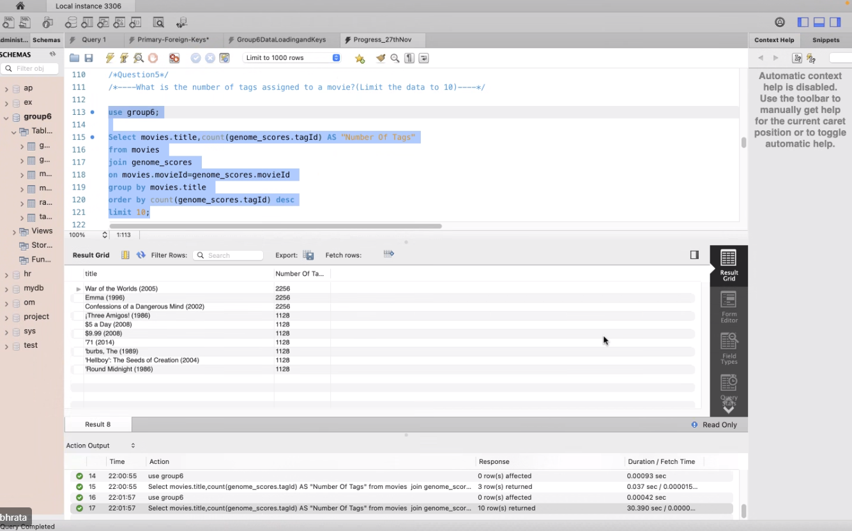
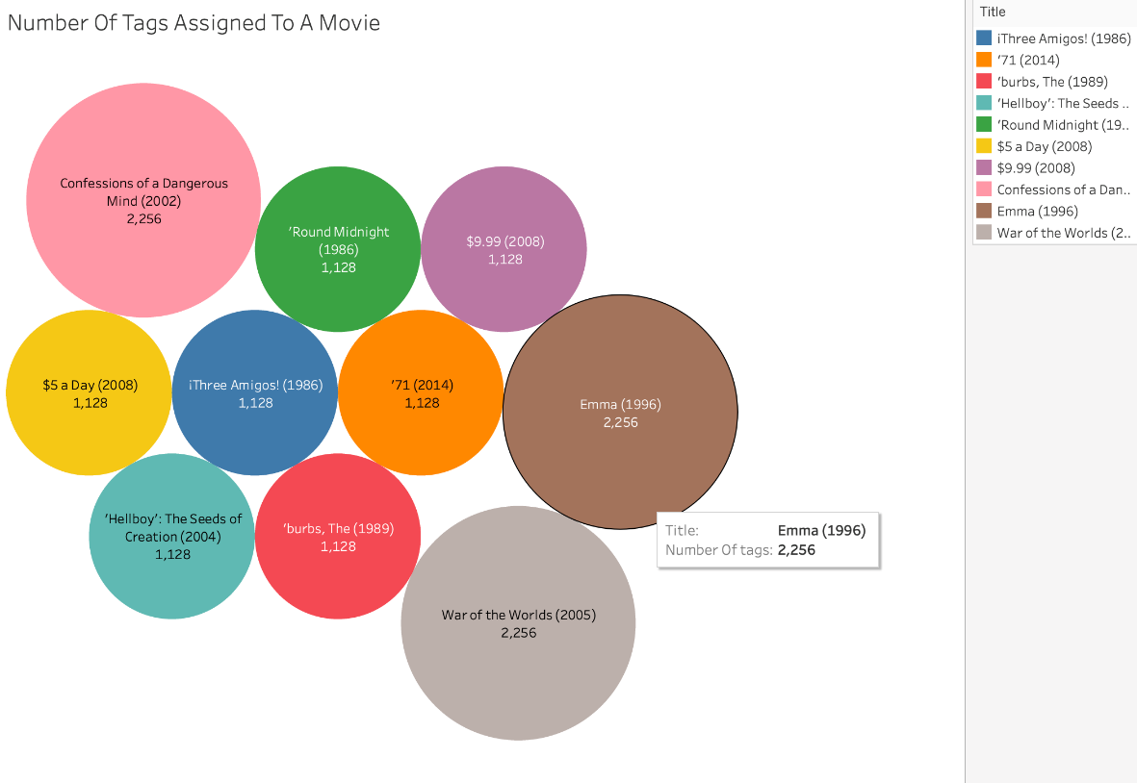
5. What is the number of tags assigned to a movie?

Slide 14
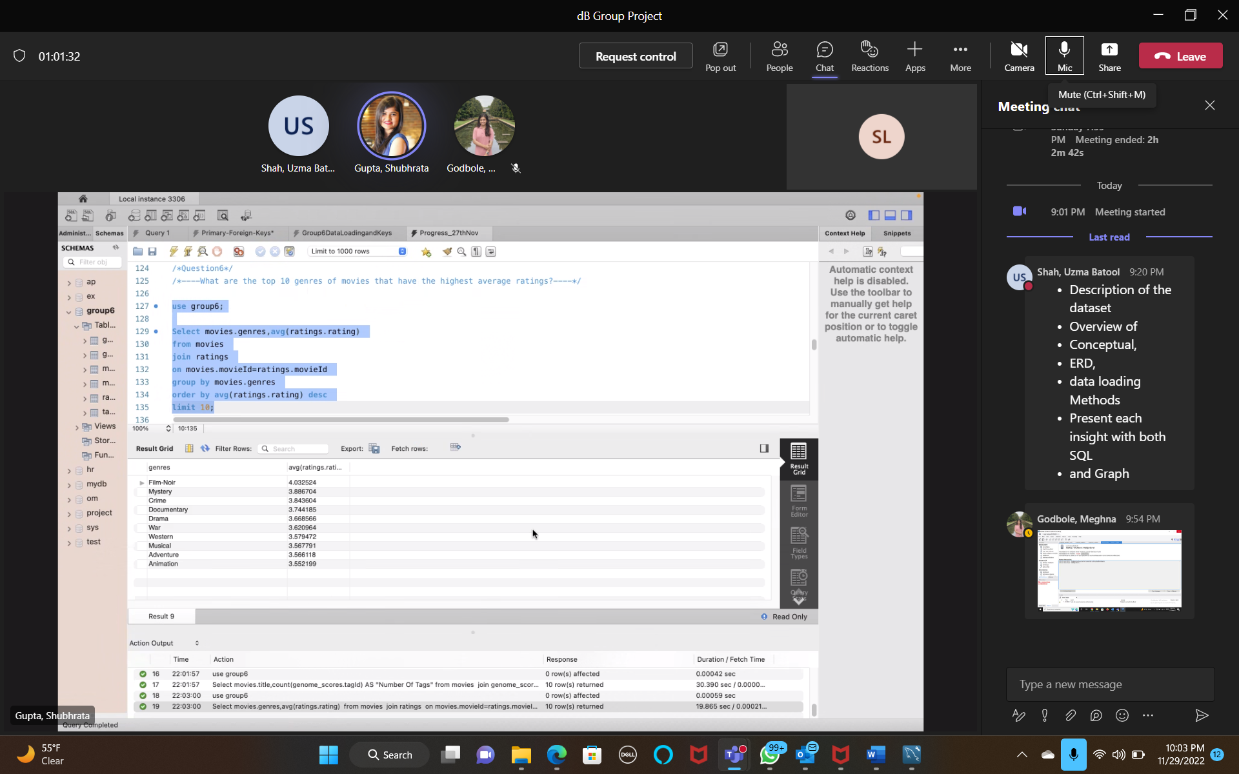
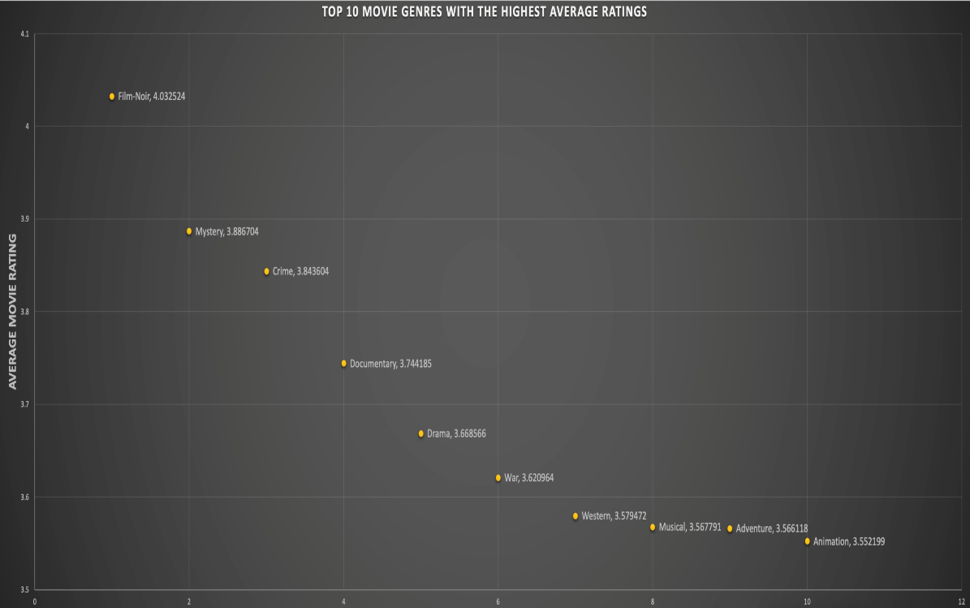
6. What are the top 10 genres of movies that have the highest average ratings?

Slide 15
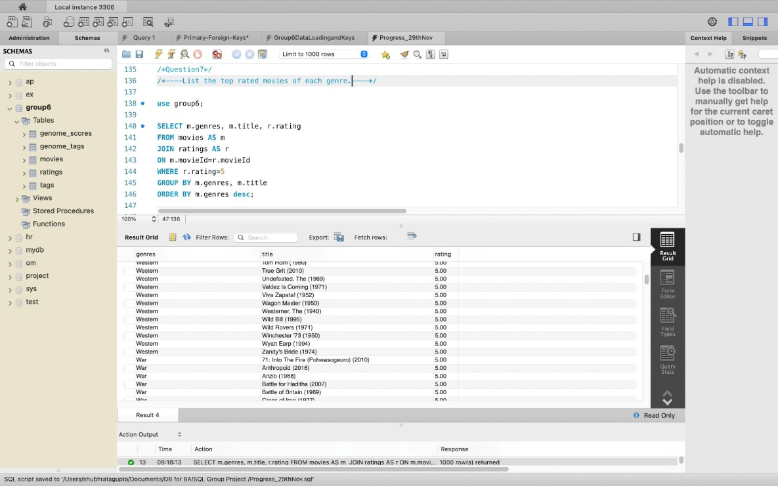
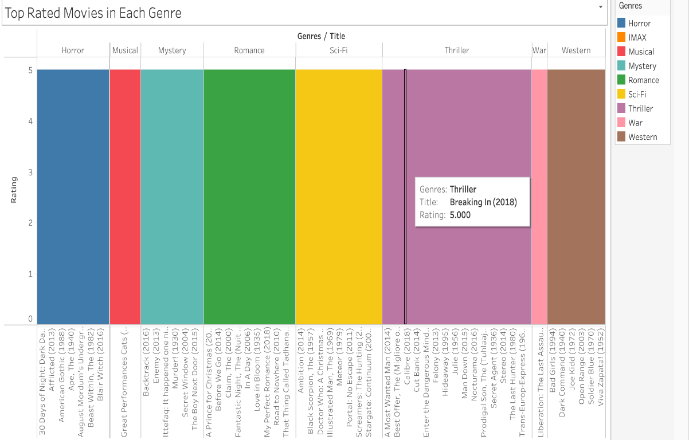
7. What are the top-rated movies in each genre?

Slide 16
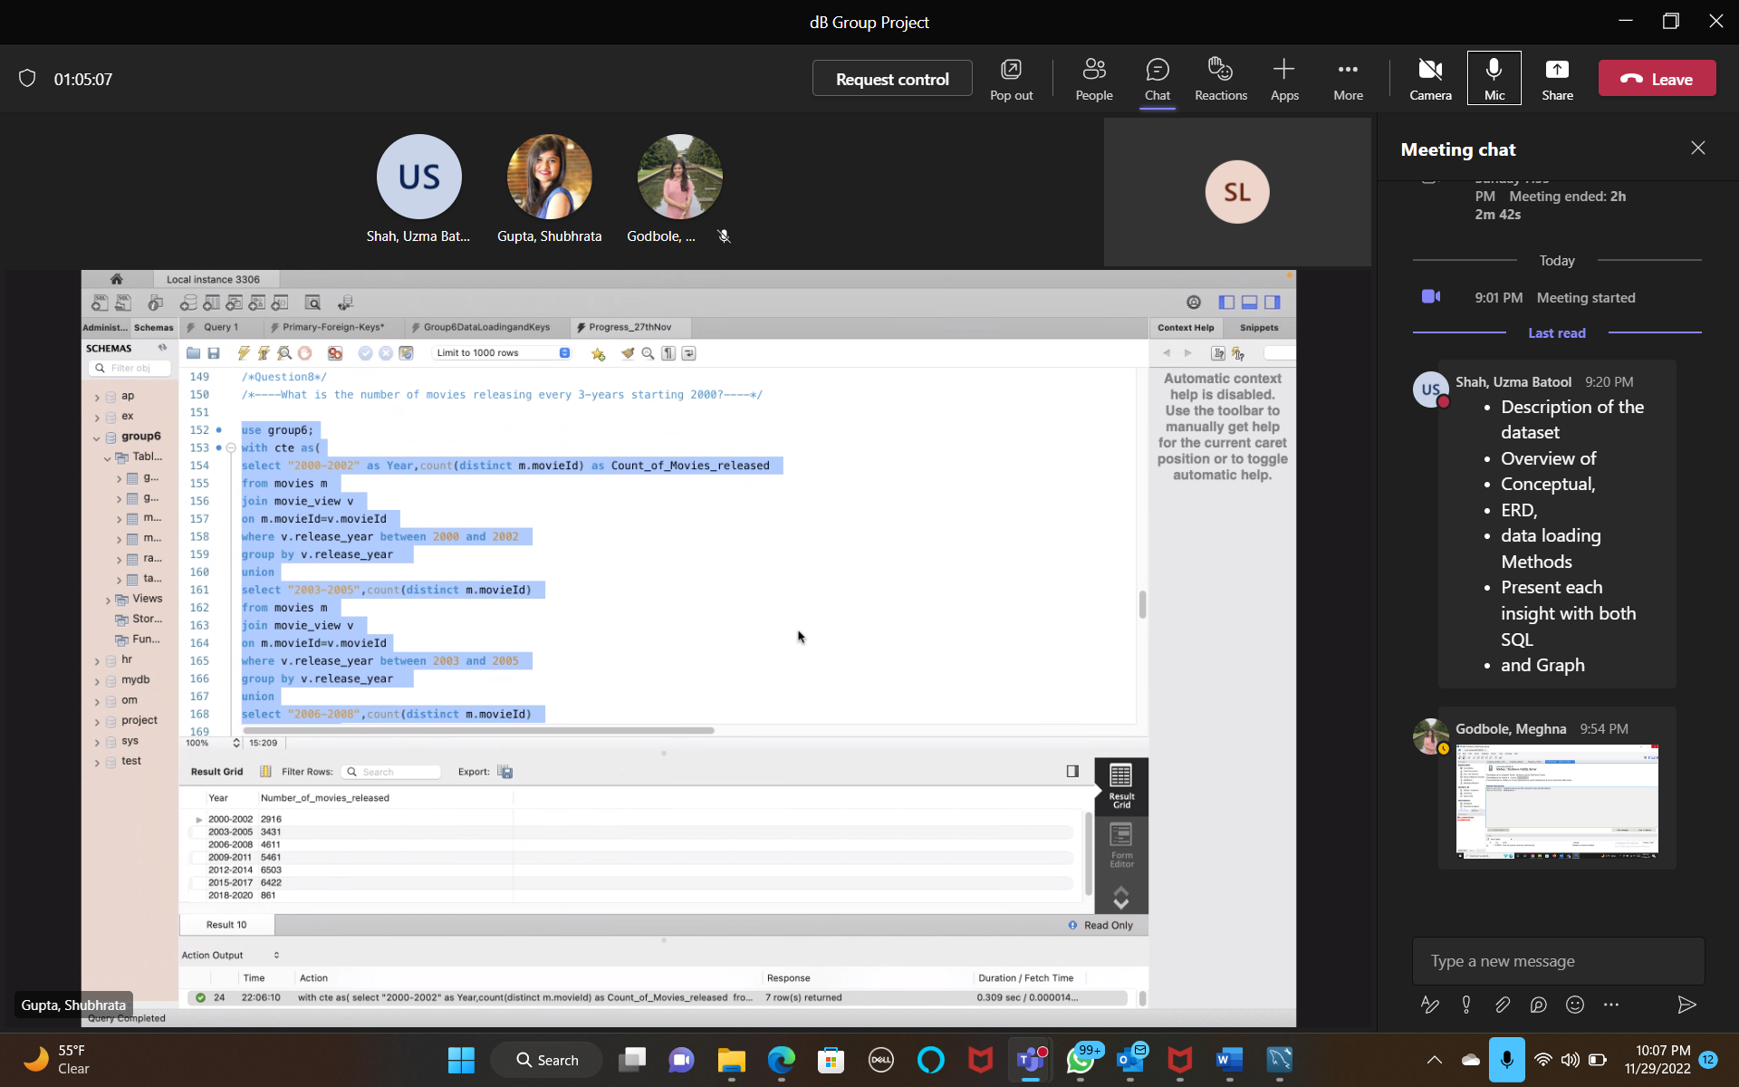
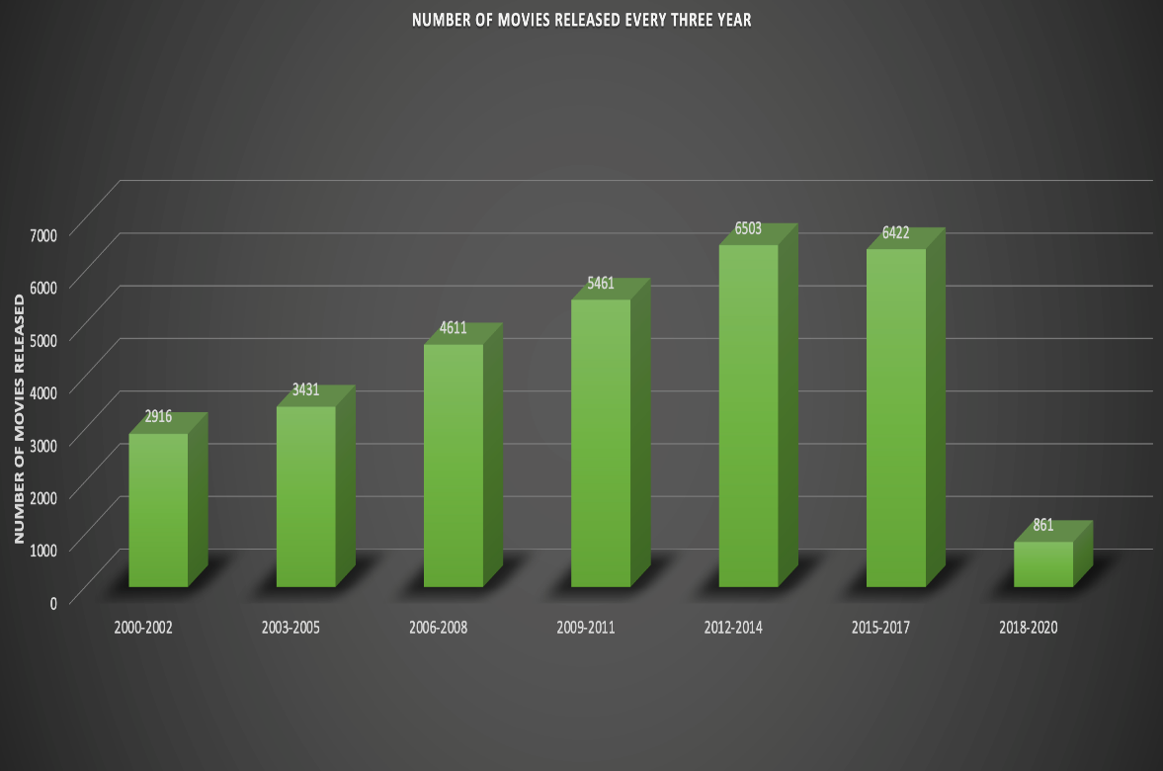
8. What was the number of movies releasing every 3-year starting 2000?

Slide 17
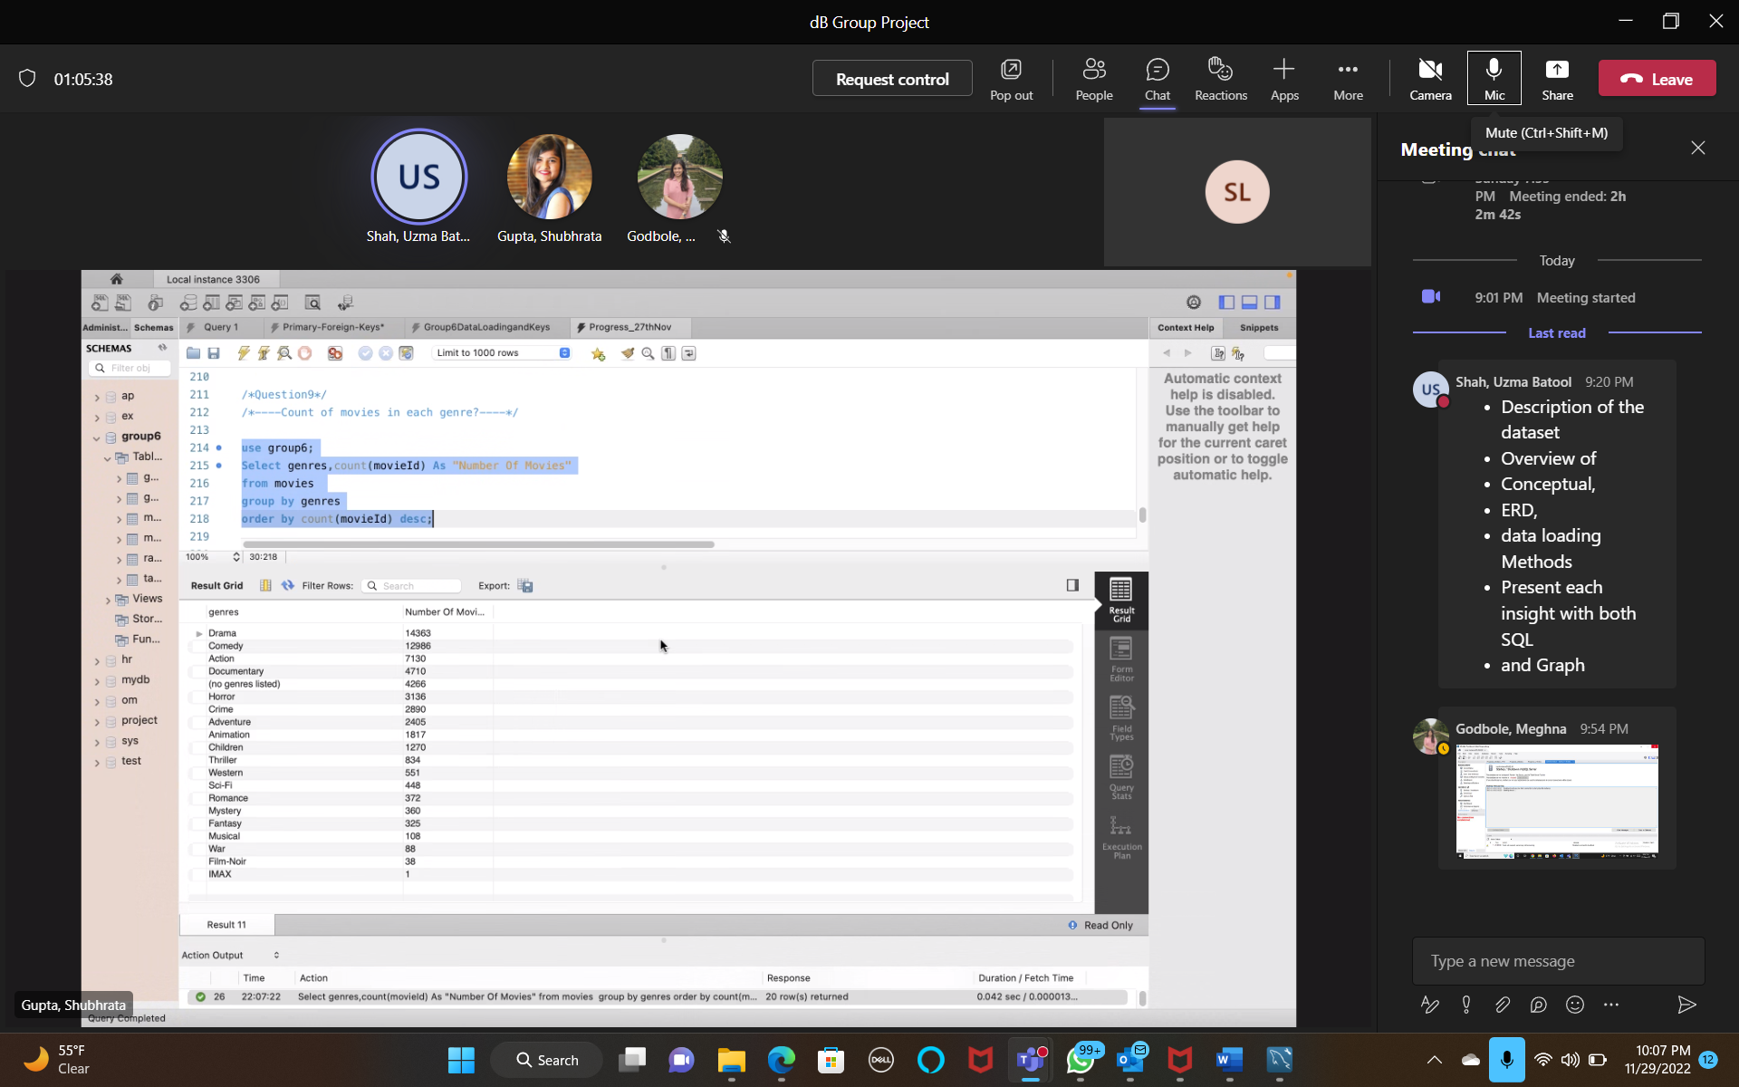
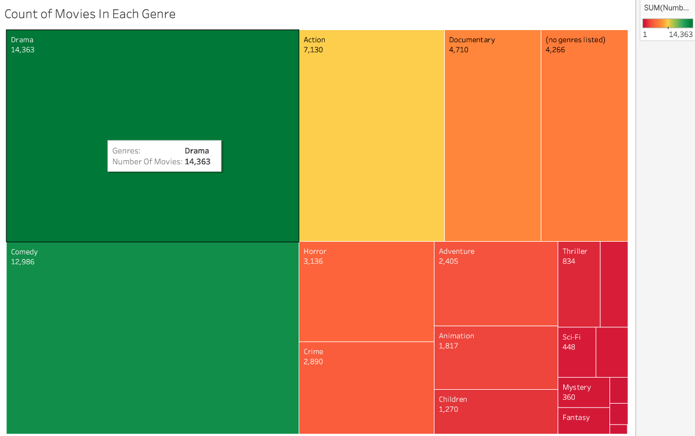
9. What is the count of movies in each genre?

Slide 18
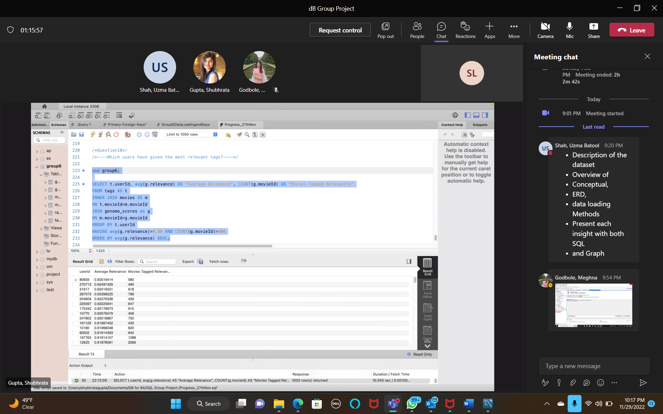
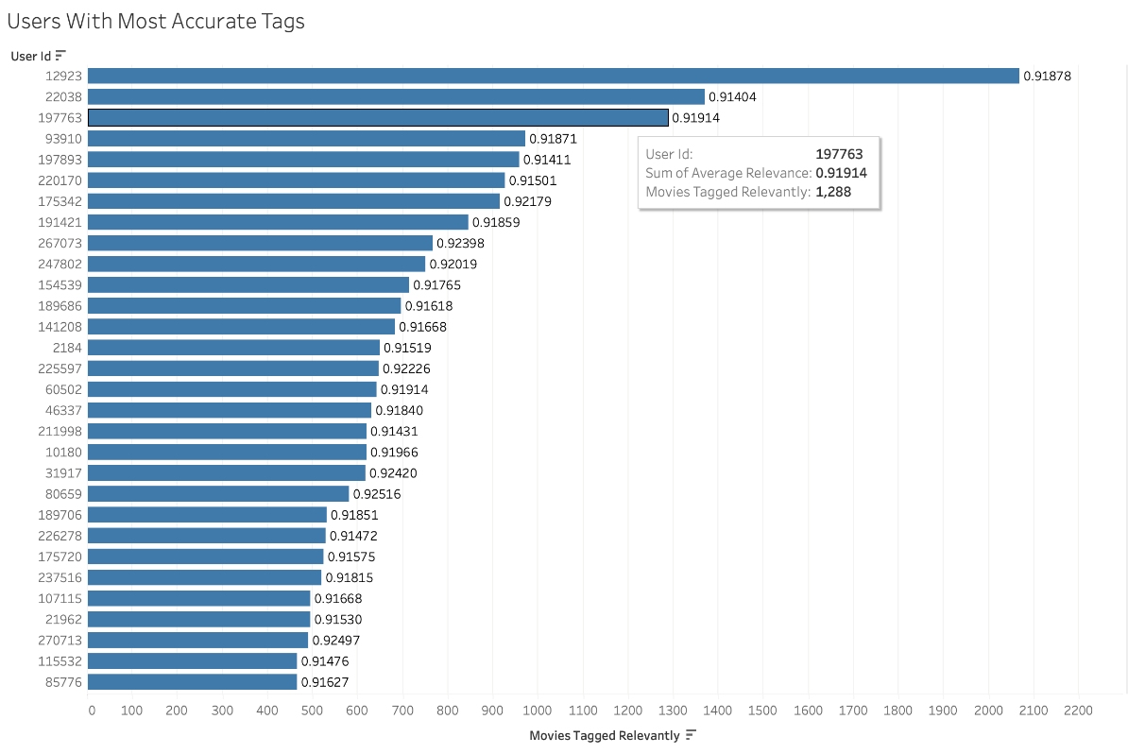
10. Which users have given the most relevant tags?

Slide 19
Conclusion:
By analyzing the datasets and drawing queries for the insights, we were able to obtain a pristine understanding of the data trends in the film industry. To draw a conclusion, we connected the 5 tables in the dataset. The dataset provided us with information sufficient to meet our business objective requirements. Based on the information, we procured visualization charts. The charts displayed the particulars about trends, relevancy, and accuracy. The statistics proved to be of use to the film industry.

Slide 20
THANK YOU!
Group Members:
Meghna Godbole
Sharon Lobo
Shubhrata Gupta
Uzma Shah
Group - 6

